Slide 1


A Secure Explainable Hybrid Framework for NAMASTE–ICD-11 Terminology Mapping
Presented By
Guided by
Senthamil Selvan S (312423205203)
Mr. Najeem Dheen Abdul Majeeth
Swarana Bairavan M (312423205222)
Assistant Professor
Information Technology
Date: 16/05/2026
1

Slide 2

Objectives
•
To integrate NAMASTE and ICD-11 medical terminologies for unified healthcare data.
•
To develop an AI-based semantic mapping system using advanced NLP techniques.
•
To reduce manual dual coding errors in AYUSH healthcare systems.
•
To implement FHIR R4 compliant interoperability for global standards.
•
To provide explainable and secure terminology mapping for clinical trust.
•
To support ABHA aligned digital health systems for national integration.
2

Slide 3

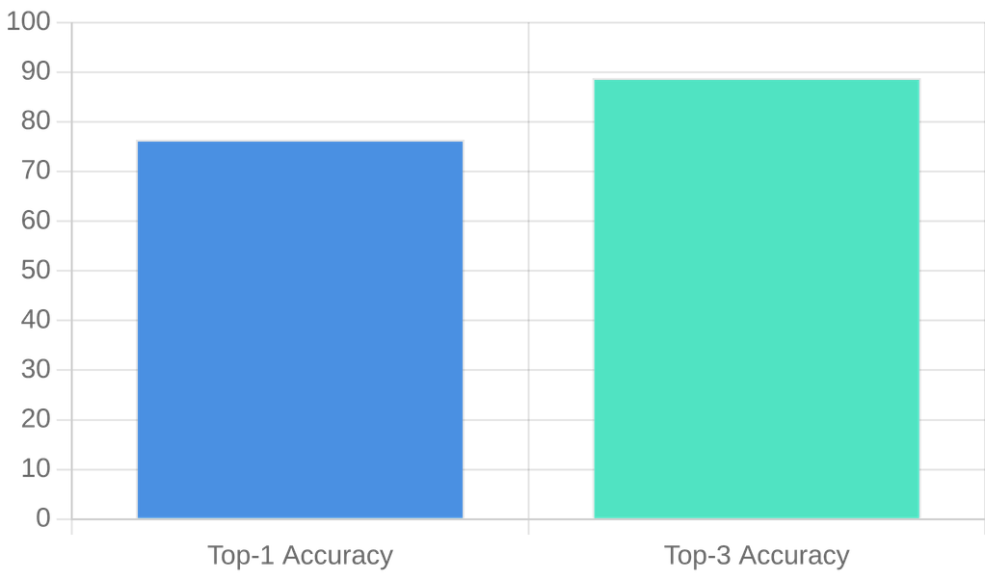
Abstract
NAMASTE and ICD-11 currently work independently, causing manual dual coding inconsistencies. This proposed system uses a hybrid symbolic and neural approach to bridge this gap.
Performance Accuracy
Key Technologies:
FHIR R4 for Interoperability
BioClinical BERT for Semantic Understanding
Explainable AI (XAI) for Transparency
OAuth2 Security for Data Protection
The system achieves high accuracy in suggesting ICD-11 codes for NAMASTE diagnoses, stored as FHIR ConceptMap resources.
3

Slide 4
Literature Survey
Technique used
Description
S.NO
Title, Author, Year
Remarks
1
M. Li et al., 2019
CNN & Deep Learning
Automated ICD coding system for clinical records.
Good accuracy
2
J. Carberry et al., 2024
Hierarchical DL
Fine-grained coding using hierarchical deep learning models.
Complex model
4

Slide 5

O
Title, Author, Year
Technique used
Description
Remarks
S.NO
3
S. Bhat et al., 2025
Rule & Deep Learning
A hybrid approach combining decision trees with neural networks for clinical data classification.
Balanced performance
4
H. Dhayne et al.,, 2019
Semantic Integration
Focuses on solving semantic heterogeneity issues for healthcare interoperability.
Focus on semantic issues
5

Slide 6
Description
Title, Author, Year
Technique used
Remarks
S.NO
5
N. Chemini et al., 2025
FHIR & Semantic Mapping
Focuses on data integration using FHIR standards.
No AYUSH mapping
6
E. N. Volkov., 2023
Explainable AI
Research on clinical AI explainability and transparency.
Transparency improved
6

Slide 7
Title, Author, Year
Technique used
Description
S.NO
Remarks
7
S. Ghanvatkar et al., 2024
XAI Metrics
Focuses on evaluating the quality of explanations provided by AI models in clinical settings.
Clinically useful for trust.
8
Y.-K. Liu et al., 2024
XAI + CDSS
Integration of Explainable AI into Clinical Decision Support Systems for trustworthy diagnosis.
Reduced cognitive load.
7

Slide 8
Title, Author, Year
Remarks
S.NO
Technique used
Description
9
J. Cleland-Huang et al.,2010
ML Compliance
Regulatory mapping for machine learning systems.
Governance support
10
WHO ICD API Docs
REST APIs
Official documentation for ICD retrieval via REST APIs.
Real-time access
8

Slide 9

Existing System
•
Clinicians manually assign both NAMASTE and ICD-11 codes for every diagnosis.
•
Heavy reliance on manual records and basic spreadsheets for data management.
•
Complete absence of AI assistance or semantic understanding of clinical terms.
•
No support for healthcare interoperability standards like FHIR.
•
Process is not scalable for large-scale healthcare deployments or national integration.
9

Slide 10
Drawbacks
Process Inefficiencies
Technical Gaps
•
Time-consuming manual coding process.
•
Lack of version control and audit logging.
•
High probability of human coding errors.
•
No FHIR integration for interoperability.
•
Poor scalability for large-scale deployment.
•
Significant security vulnerabilities.
•
No AI assistance or semantic understanding.
•
Absence of formal governance workflows.
10

Slide 11
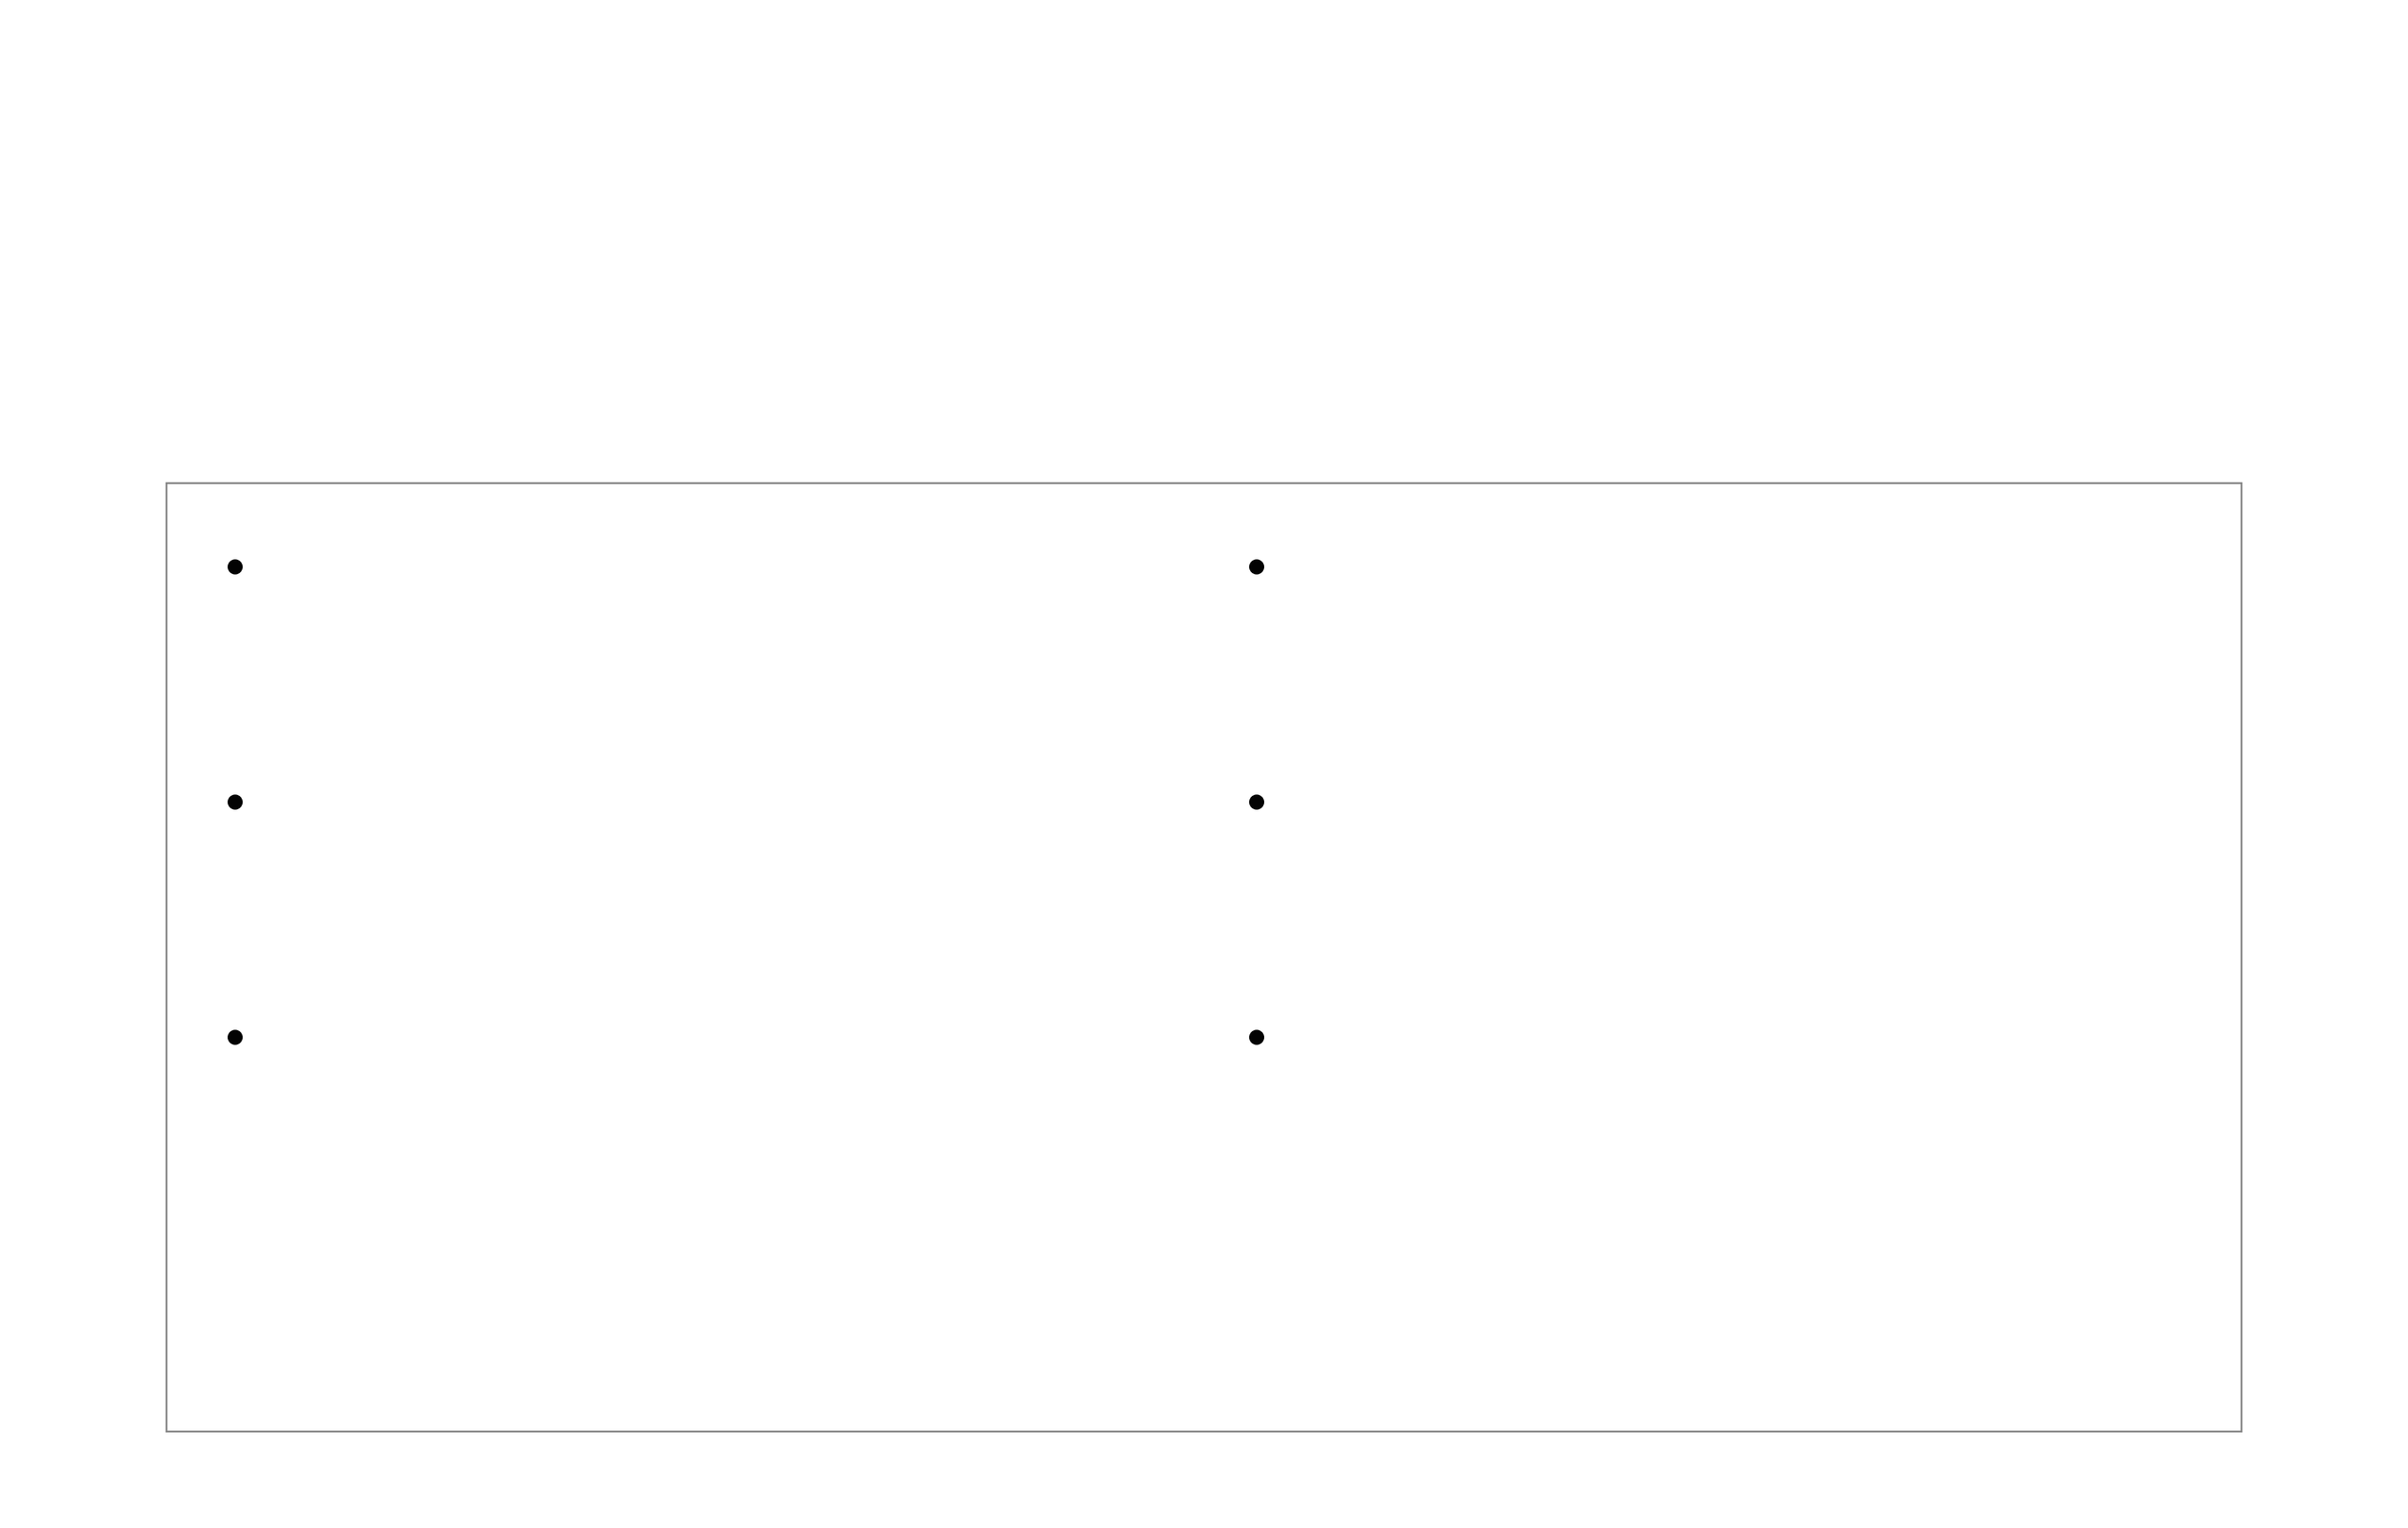
Proposed System
AI-Powered Semantic Mapping
Utilizes BioClinical BERT embeddings for deep clinical terminology understanding.
Approval Workflow
Confidence-based system for human-in-the-loop verification.
FHIR R4 Interoperability
Standardized healthcare data exchange for global compatibility.
OAuth2 + JWT Security
Robust authentication and authorization for sensitive medical data.
Ontology Validation
Rule-based validation ensures clinical accuracy and logical consistency.
FHIR ConceptMap Storage
Final mappings stored as standardized, queryable resources.
11

Slide 12

Algorithm Used
BioClinical BERT
Cosine Similarity
Hybrid Scoring
• Generates deep semantic embeddings for clinical text.
• Measures the angular distance between concept vectors.
• Combines neural similarity with rule-based validation.
• Pre-trained on large-scale medical corporation (MIMIC-III).
• Determines the semantic closeness of NAMASTE and ICD-11.
• Confidence Calibration for approval workflows.
• Captures complex medical terminology nuances.
• Robust to variations in text length and phrasing.
• Ensures high precision in final code suggestions.
12

Slide 13

Advantages
•
Reduces Clinician Workload - Automates the tedious process of mapping clinical terms to ICD-11 codes.
•
Explainable AI Decisions - Provides transparency and reasoning for every suggested mapping.
•
Secure & Scalable - Enterprise-grade architecture designed to grow with healthcare needs.
•
Real-time Semantic Mapping - Instantaneous processing of clinical concepts for immediate use.
•
Supports ABHA Standards - Fully compliant with national digital health ecosystem requirements.
13

Slide 14

System Requirements
Hardware Requirements
Software Requirements
Intel Core i5 Processor
Java 17 & Spring Boot
16 GB RAM
Python 3.10+
256 GB SSD
React.js
NVIDIA GTX 1650 (Optional)
PostgreSQL
FHIR R4
OAuth2 + JWT
14

Slide 15

System Architecture
Architectural Layers
System Workflow
5. Persistence Layer (FHIR ConceptMap)
NAMASTE Concepts
4. Governance Layer (Review Workflow)
3. Validation Layer (Rule Engine)
AI Semantic
2. Semantic Processing Layer (BioClinical BERT)
1. Terminology Ingestion Layer (NAMASTE/ICD-11)
ICD-11 Mapping
Validation & Approval
FHIR Standard Storage
15

Slide 16

Modules
Terminology Ingestion Module
Semantic Similarity Engine
Rule Validation Module
Governance Workflow Module
FHIR Persistence Module
16

Slide 17

Module Description
Terminology Ingestion Module
Loads NAMASTE concepts directly from source files or integrated APIs.
Retrieves ICD-11 entities dynamically to ensure the system uses the most up-to-date terminology.
Uses WHO ICD API for official and authoritative classification data retrieval.
Converts data into FHIR CodeSystem resources for standardized internal representation and interoperability.
17

Slide 18

Module Description
Semantic Similarity Engine
Uses Bio Clinical BERT: Leverages specialized transformer models pre-trained on medical corpora.
Text-to-Embeddings: Converts clinical text into high-dimensional vector representations.
Cosine Similarity: Computes mathematical proximity between NAMASTE and ICD-11 embeddings.
Top-3 Suggestions: Generates the most relevant ICD-11 candidates for clinical validation.
18
.

Slide 19

Module Description
Rule Validation Module
Validates hierarchy consistency within the ICD-11 structure.
Checks equivalence constraints to prevent logically impossible mappings.
Performs keyword matching as a secondary verification layer.
Improves mapping accuracy by filtering out semantically similar but clinically incorrect results.
19

Slide 20

Module Description
Governance Workflow Module
•
Confidence-based routing: Intelligently directs mapping results based on AI-calculated similarity scores.
•
Auto-approval system: Automatically validates mappings with high confidence scores to maximize efficiency.
•
Expert review workflow: Routes medium-confidence mappings to clinical experts for manual verification.
•
Low-confidence flagging: Identifies and flags ambiguous concepts for detailed investigation and terminology refinement.
20

Slide 21

Module Description
FHIR Persistence Module
Stores approved mappings: Securely persists validated clinical concept mappings in a centralized repository.
Uses FHIR ConceptMap resources: Adheres to HL7 FHIR standards for representing terminology mappings.
Maintains version control: Tracks historical changes and updates to mapping definitions over time.
Supports audit logging: Records all persistence operations to ensure full traceability and compliance.

Slide 22

Output – Terminology Ingestion
Ingestion Dashboard - NAMASTE v1.2
Concept ID
Clinical Term
Status
FHIR Resource
N-1024
Acute Myocardial Infarction
Loaded
CodeSystem/AMI-01
N-1025
Type 2 Diabetes Mellitus
Loaded
CodeSystem/T2DM-02
Features
N-1026
Chronic Kidney Disease
Processing
Pending...
•
NAMASTE concept loading
•
ICD retrieval
•
FHIR conversion
Total Concepts: 1,240
WHO ICD API: Connected
22

Slide 23


Output – Semantic Similarity
Search NAMASTE Concept: "Acute Myocardial Infarction"
AI SUGGESTIONS (ICD-11)
ICD-11 Code
Description
Similarity Score
Features
BA41.1
Acute myocardial infarction, ST elevation
0.9842
BA41.2
Acute myocardial infarction, non-ST elevation
0.8519
•
User input panel
BA41.Z
Acute myocardial infarction, unspecified
0.7231
•
AI-generated suggestions
•
Similarity scores
23

Slide 24

Output – Mapping Suggestion View
Final Mapping Suggestions
Status: Ready for Review
RANK 1 - ICD-11 CODE
BA41.1 - Essential Hypertension
Confidence
98%
XAI Highlight: "High correlation with clinical history of elevated blood pressure"
RANK 2 - ICD-11 CODE
Confidence
85%
BA41.Z - Hypertension, unspecified
RANK 3 - ICD-11 CODE
Confidence
72%
BC40.0 - Secondary Hypertension
24

Slide 25


Output – Clinician Review Workflow
Clinician Review Dashboard
Approval/rejection system
Mapping Verification
Governance workflow
Approve
Reject
NAMASTE: Amavata
→
ICD-11: Rheumatoid Arthritis
Audit tracking
NAMASTE: Jwara
→
ICD-11: Fever, unspecified
Approve
Reject
* Audit Log: User Dr. Sharma logged in at 10:45 AM

Slide 26

Conclusion
Successfully integrated NAMASTE with ICD-11
Implemented Explainable AI semantic mapping
Achieved high mapping accuracy
Reduced manual coding complexity
Ensured secure and governed interoperability
Supports India’s digital healthcare mission

Slide 27

Future Enhancement
Integration with live ABHA systems
Multi-institution deployment
Fine-tuned AYUSH language models
Federated learning support
Expanded validation dataset
Advanced explainability dashboards

Slide 28

References
[1] M. Li et al., "Automated ICD-9 Coding via a Deep Learning Approach," IEEE/ACM Trans. Comput. Biol. Bioinf., vol. 16, no. 4, pp. 1331–1341, 2019
[2] J. Carberry and H. Xu, "A Hierarchical Fine-Grained Deep Learning Model for Automated Medical Coding," in Proc. IEEE ICHI, 2024.
[3] S. Bhat et al., "Automated Medical Coding Using a Hybrid Decision Tree with Deep Learning Nodes," in Proc. IEEE BigDataService, 2025.
[4] H. Dhayne et al., "In Search of Big Medical Data Integration Solutions — A Comprehensive Survey," IEEE Access, vol. 7, pp. 91265–91290, 2019.
[5] N. Chemini et al., "Standardized Semantic Mapping and Legacy Data Integration in Blockchain-Based EHR Systems: A Survey," IEEE J. Biomed. Health Inform., 2025.
Page 28

Slide 29

References
[6] E. N. Volkov and A. N. Averkin, "Explainable Artificial Intelligence in Clinical Decision Support Systems," in Proc. IEEE NeuroNT, 2023.
[7] S. Ghanvatkar and V. Rajan, "Evaluating Explanations From AI Algorithms for Clinical Decision-Making," IEEE J. Biomed. Health Inform., vol. 28, no. 3, 2024.
[8]Y.-K. Liu et al., "Explainable AI for Trustworthy Clinical Decision Support," in Proc. IEEE Big Data, 2024.
[9] J. Cleland-Huang et al., "A Machine Learning Approach for Tracing Regulatory Codes to Product-Specific Requirements," in Proc. IEEE ICSE, 2010.
29

